Slide 1

T5 SDAIA BOOTCAMP DATA SCINCE PROJECT
CALIFORNIA HOUSING PRICES
Maha Aladwani
Yazeed Alharthi
Hala Alenzai

Slide 2
Main
Topics
Outline
Introduction
About the data
Challenges
EDA Questions
Algorithms
Tools
Conclusion

Slide 3
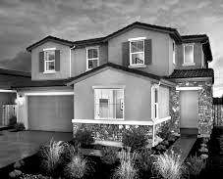
The data pertains to the houses found in each California district and some summary statistics about them based on the 1990 census data.
The goal of this project is to implement machine learning(Regression) algorithms.
Introduction

Slide 4
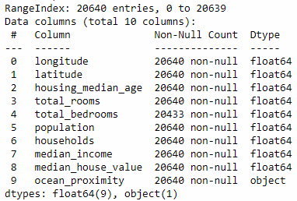
ABOUT THE DATA
DATA COUNT
DATA TYPE
It contained 20,640 observations on 10 features.
It had 9 float features and 1 object feature
THE DEPENDENT VARIABLE
median house value
The dataset found at Kaggle

Slide 5
Challenges
Outliers.
Null values.
Dealing with over-fitting model.
Choosing the right model.

Slide 6
EDA Questions
Does the age of the house affect on the house value?
What do people prefer on their house location?
Does the proximity of the house to the ocean affect its price?
What is the most city has the highest population?

Slide 7
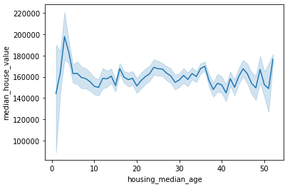
Does the age of the house affect on the
house value?

Slide 8
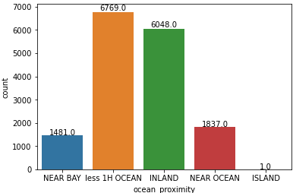
Where does people prefer on their house location?

Slide 9
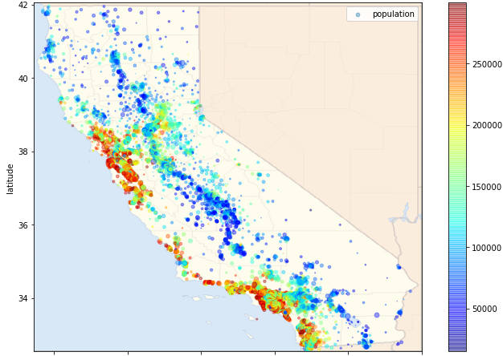
Does the proximity from the house to the ocean affect its price?

Slide 10
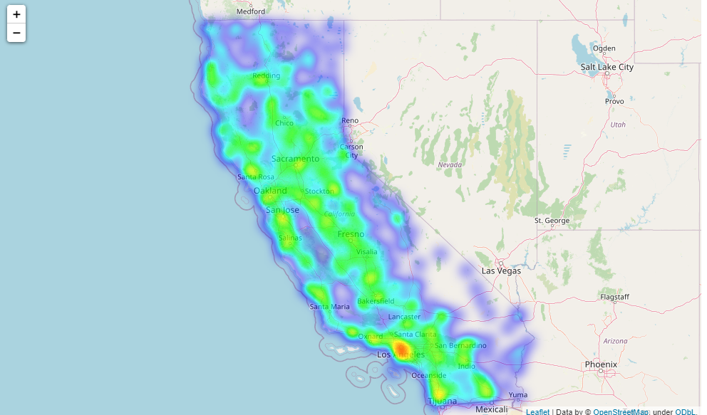
What is the most city that had the highest population?

Slide 11
Algorithms
Linear Regression
Decision tree regressor
Lasso Regression
Ridge Regression
Random Forest Regressor
Polynomial Regression

Slide 12
Models
Root Mean Square Error | Mean Absolute Error | R² Test | R² Train | Model
41973.371 | 1761763937.589 | 0.583 | 0.595 | Linear Regression
44080.770 | 1943114352.714 | 0.540 | 0.573 | Decision tree regressor
33584487.723 | 1127917815639476.2 | 0.583 | 0.595 | Lasso Regression
33566615.050 | 1126717645962416.8 | 0.583 | 0.595 | Ridge Regression
44483.898 | 1978817223.968 | 0.532 | 0.906 | Random Forest Regressor
38219.439 | 1460725554.369 | 0.613 | 0.656 | Polynomial Regression

Slide 13
Pandas
NumPy
Matplotlib
Seaborn
Scikit-learn
Math library
Folium
PowerPoint, Canva
Zoom
Tools

Slide 14
Conclusion
We noticed during the project, that model Polynomial Regression and Linear Regression gave us the best results among the models, and it can help the real estate companies to predict California housing prices.

Slide 15
Thank You

